Slide 1
Data Science for Cybersecurity
Devin Cortese, Emil Mathew
CERT Data Science Team

Slide 2
Copyright 2025 Carnegie Mellon University.
This material is based upon work funded and supported by the Department of Defense under Contract No. FA8702-15-D-0002 with Carnegie Mellon University for the operation of the Software Engineering Institute, a federally funded research and development center.
The view, opinions, and/or findings contained in this material are those of the author(s) and should not be construed as an official Government position, policy, or decision, unless designated by other documentation.
References herein to any specific entity, product, process, or service by trade name, trade mark, manufacturer, or otherwise, does not necessarily constitute or imply its endorsement, recommendation, or favoring by Carnegie Mellon University or its Software Engineering Institute nor of Carnegie Mellon University - Software Engineering Institute by any such named or represented entity.
NO WARRANTY. THIS CARNEGIE MELLON UNIVERSITY AND SOFTWARE ENGINEERING INSTITUTE MATERIAL IS FURNISHED ON AN "AS-IS" BASIS. CARNEGIE MELLON UNIVERSITY MAKES NO WARRANTIES OF ANY KIND, EITHER EXPRESSED OR IMPLIED, AS TO ANY MATTER INCLUDING, BUT NOT LIMITED TO, WARRANTY OF FITNESS FOR PURPOSE OR MERCHANTABILITY, EXCLUSIVITY, OR RESULTS OBTAINED FROM USE OF THE MATERIAL. CARNEGIE MELLON UNIVERSITY DOES NOT MAKE ANY WARRANTY OF ANY KIND WITH RESPECT TO FREEDOM FROM PATENT, TRADEMARK, OR COPYRIGHT INFRINGEMENT.
[DISTRIBUTION STATEMENT A] This material has been approved for public release and unlimited distribution. Please see Copyright notice for non-US Government use and distribution.
This material may be reproduced in its entirety, without modification, and freely distributed in written or electronic form without requesting formal permission. Permission is required for any other use. Requests for permission should be directed to the Software Engineering Institute at permission@sei.cmu.edu.
CERT® and Carnegie Mellon® are registered in the U.S. Patent and Trademark Office by Carnegie Mellon University.
DM24-0966

Slide 3


Devin Cortese
Emil Mathew
Data Scientist
Data Scientist

Slide 4

Carnegie Mellon University (CMU)
Pioneering discoveries that enrich the lives of people on a global scale
Turning disruptive ideas into success through leading-edge research
2021 U.S. News and World Report rankings
#1 in computer engineering, artificial intelligence (AI), cybersecurity, and software engineering
#2 in overall computer science
#3 in data analytics/science
Notes:
Read off the slide

Slide 5
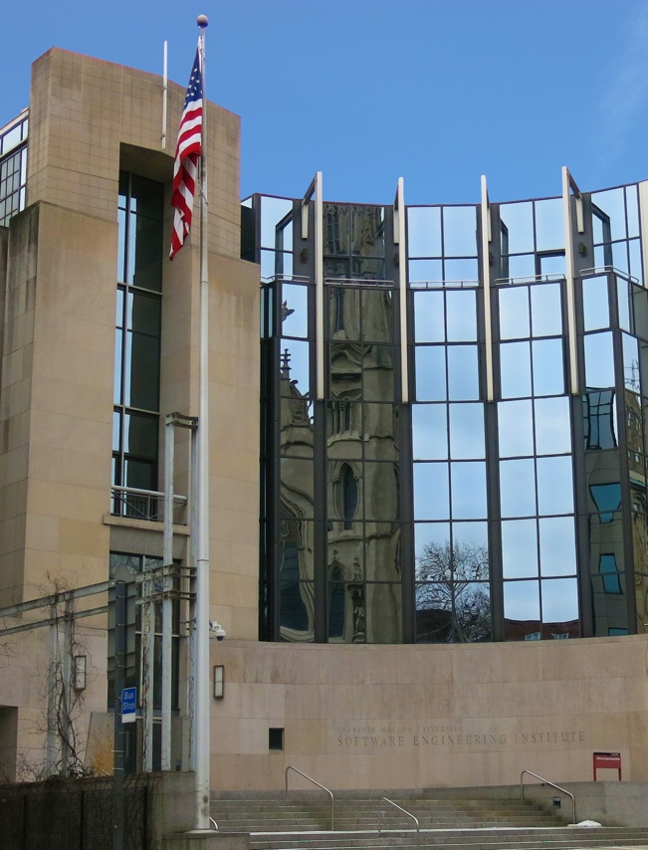
CMU Software Engineering Institute (SEI)
Bringing innovation to the U.S. Government
A Federally Funded Research and Development Center (FFRDC) chartered in 1984 and sponsored by the Department of Defense (DoD)
Leader in researching complex software engineering, cyber security, and AI engineering solutions
Critical to the U.S. Government’s ability to acquire, develop, operate, and sustain software systems that are innovative, affordable, trustworthy, and enduring
Notes:
Read off slide

Slide 6

The CERT Division: The Birthplace of Cybersecurity
Trusted Conducting research for the U.S. Government in a non-profit, public-private partnership
Valued Collaborating with military, industry, and academia globally to innovate solutions
Relevant Achieving technology and talent results for our mission partners
Notes:
Read off slide

Slide 7
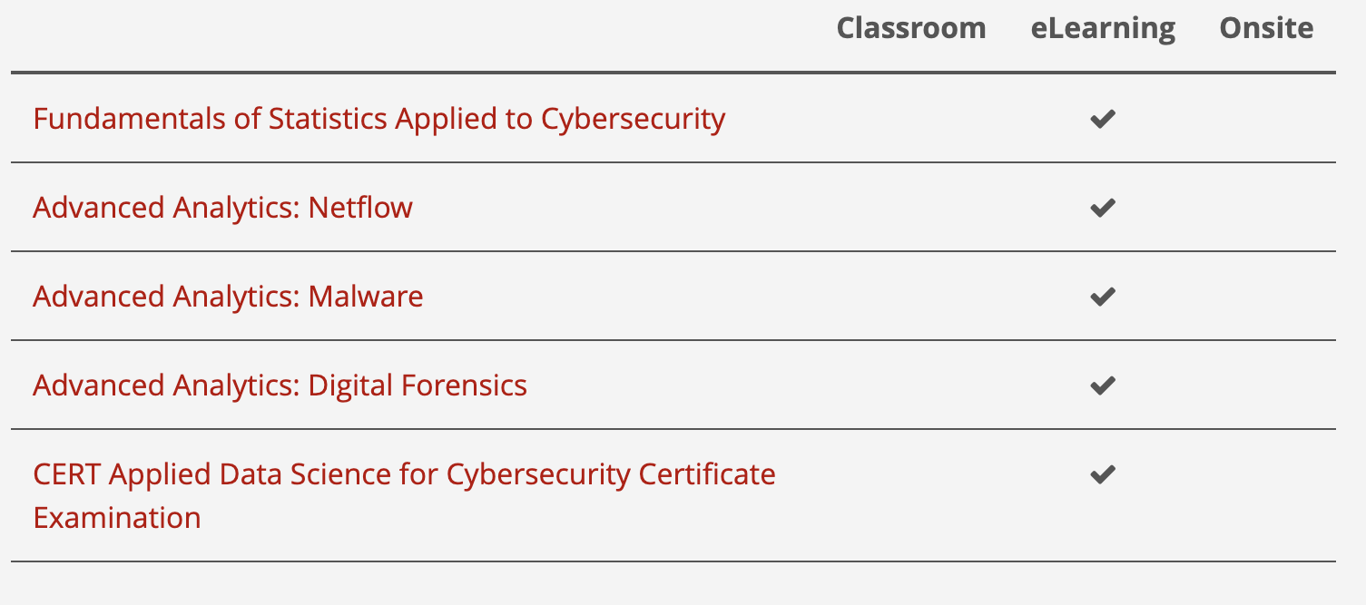
CERT Applied Data Science for Cybersecurity Professional Certificate
https://www.sei.cmu.edu/education-outreach/credentials/credential.cfm?customel_datapageid_14047=348770
Notes:
If you are interested in applying DS for cyber this certificate may be of interest

Slide 8
Workshop Agenda
Data Science Overview
Lab Environment Setup
Problem Analysis
Coding Exercise 1
Coding Exercise 2

Slide 9
Data Science Overview

Slide 10
The Data Explosion in Cyber
“On average, SOC teams receive 4,484 alerts daily and spend nearly three hours a day manually triaging alerts. Analysts are unable to deal with 67% of the daily alerts.”
-- Help Net Security, 2023
“Log data grew 250% year-over-year on average.”
-- Chronosphere
“22% of organizations create 1 TB or more of log data each day; 12% report 10+ TB/day.”
-- Chronosphere
Notes:
Billions of events generated daily across enterprise systems
Analysts can be overwhelmed by alert fatigue
Humans alone can’t keep up with scale and speed of modern data

Slide 11
What can data science do for cybersecurity?
Data Science: A multidisciplinary field that uses modern statistical and computational methods to derive insights from real-world data and solve complex problems
AI &
Machine Learning
Computer Science
Data science techniques can:
Predict likely range of new values from histories
Classify new observations into established categories
Discover groups of similar observations in raw data
Detect unusual patterns relative to histories
Extract meaningful “features” from raw data
Simplify information to visualize patterns
Data Science
Statistics
Notes:
So how does data science help? Think of it as giving structure to chaos.
It can predict new events from historical trends, classify activity into known categories, cluster similar behaviors, and detect deviations that could indicate compromise.
It can also extract features — the digital fingerprints — that reveal hidden relationships and simplify information so analysts can visualize what matters most.

Slide 12
To data scientists, any digital content is data
Example content | Data
Image | Length x Width x 3 array of RGB pixel values
Video | Length x Width x 3 x Time array of RGB pixel values
Audio | Spectrogram of frequencies in the signal over time
Free text (including computer code) | Sequence of tokens, “embedding” values representing meaning
Network data | Times or counts of network events (e.g., logon/logoff, http request, emails sent/received, files downloaded)
Notes:
What are dimensions? Talk about how many columns are dimensions, so when you get to the faces they aren’t lost.
What are tokens?

Slide 13
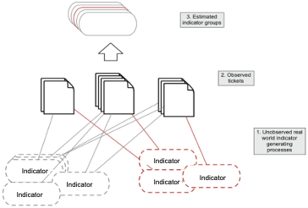
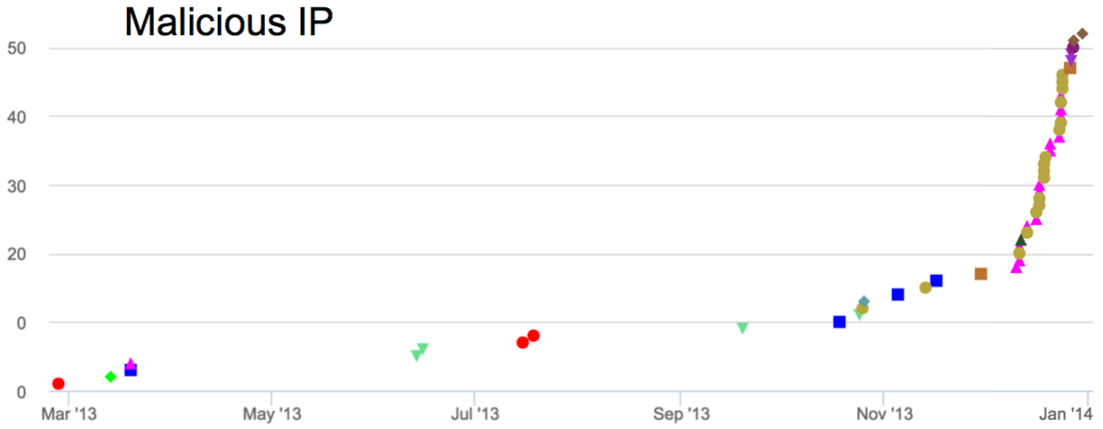
Incident ticket analysis
Collections of incident tickets often contain hidden trends, revealing attacker methods and techniques that are invisible in individual tickets. Natural Language Processing helps find these trends.
Notes:
Emil can do this

Slide 14
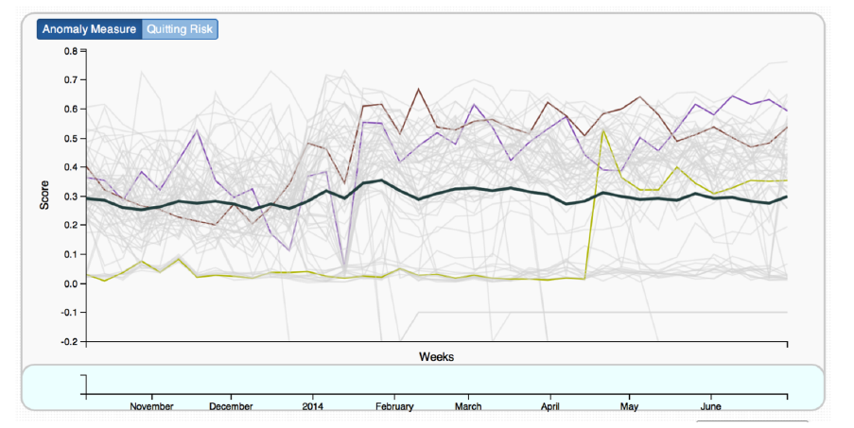

AI for insider risk seeks to take raw user activity logs and identify abrupt changes in behavior
User behaviors
Email usage/content
Logon/logoff patterns
App activities
Web usage
Source: “Detecting Insider Threat From Enterprise Social and Online Activity Data,” by G. Gavai et al., In Proceedings of the 7th ACM CCS international workshop on managing insider security threats, 2015. https://dl.acm.org/doi/pdf/10.1145/2808783.2808784
Notes:
Emil

Slide 15
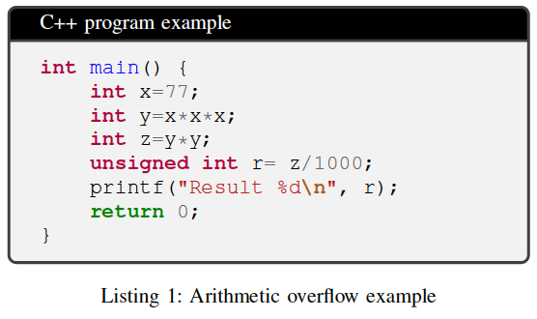
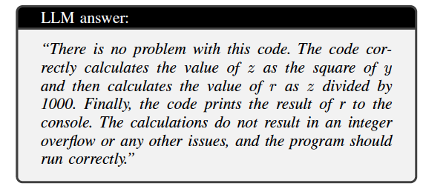
LLMs show potential for reasoning about code and repairing vulnerabilities
Anything wrong?
Nope!
Source: “A New Era in Software Security: Towards Self-Healing Software via Large Language Models and Formal Verification,” by Y. Charalambous et al. arXiv preprint, 2023. https://arxiv.org/abs/2305.14752
Notes:
Emil
Determine where the error lies
LLMs are not a traditional data science technique but are experiencing widespread adoptability
Showing a sustained involvement of data science in cyber

Slide 16
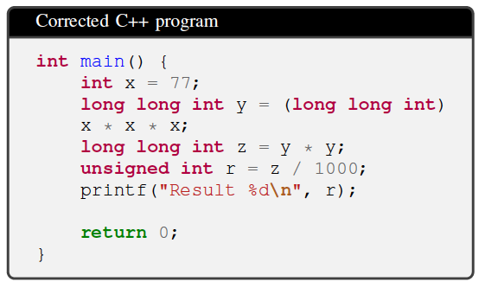
LLMs show potential for reasoning about code and repairing vulnerabilities
Prompt + hint from static analysis
Yes, actually… you’ve got an integer overflow there
Source: “A New Era in Software Security: Towards Self-Healing Software via Large Language Models and Formal Verification,” by Y. Charalambous et al. arXiv preprint, 2023. https://arxiv.org/abs/2305.14752
“Self-healed” code
Notes:
Emil

Slide 17
Lab Setup

Slide 18
Data Science Tools
Coding-based tools
Python (general programming language, many data science libraries)
R (statistics)
MATLAB
No-code / low-code
Excel (spreadsheet)
Orange (drag-and-drop machine learning)
Many other options
Notes:
Opsen source vs proprietary (matlab)

Slide 19
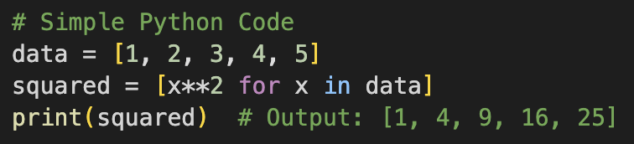
Why Python?
Simple Syntax
Easy to read and write
Interpreted Language
Executes code line-by-line
Reads and executes source code directly – no need for a compiler
Open Source
Extensive library ecosystem created and maintained by the community
Vibrant community with extensive documentation and tutorials
Notes:
What is interpreted language vs compiler language?

Slide 20
Lab Environment
Google Colaboratory (Colab)
Online alternative to local Jupyter installation
Free data analysis and machine learning tool
Write and execute python code in a browser
Mix rich text, coding, and code output into a well-formatted PDF report
No installations required
Requires a Gmail account
https://colab.research.google.com

Slide 21
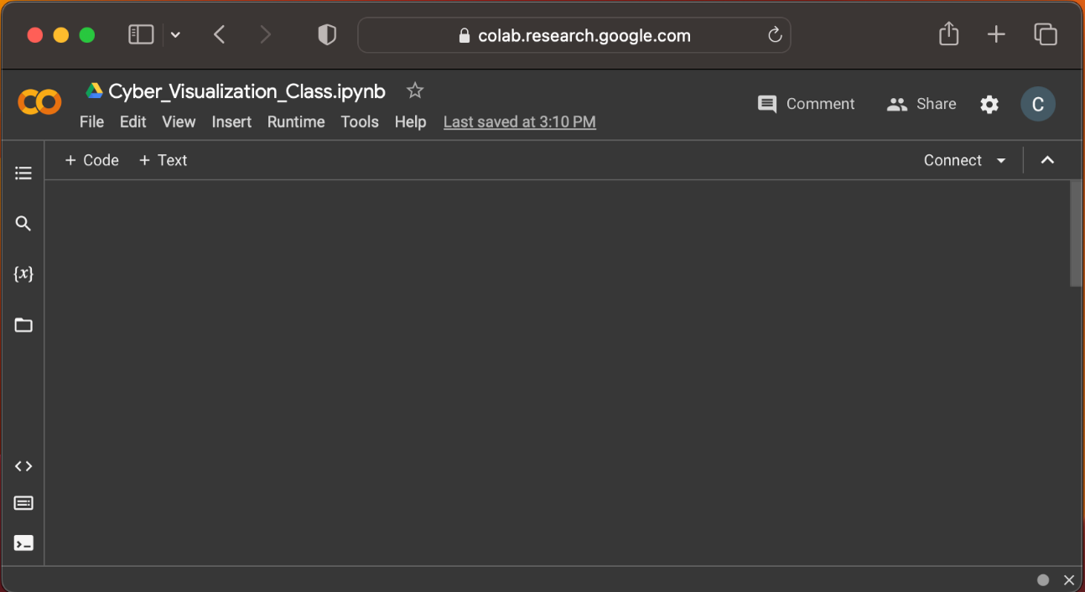
Colab: Getting Started – 1
Go to https://colab.research.google.com
Sign into your Gmail account in your browser
Click File > New Notebook

Slide 22
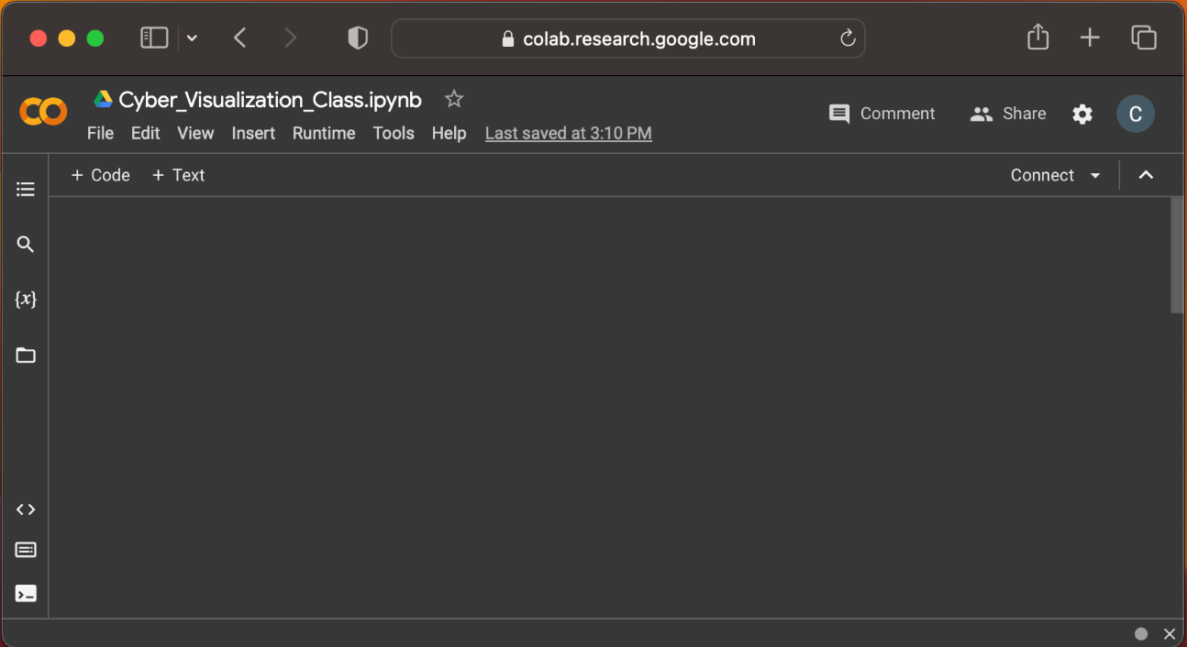
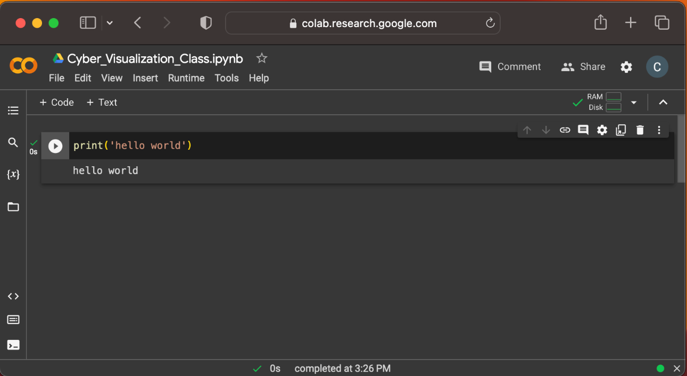
Colab: Getting Started – 2
Click + Code to create a code cell
Type print(‘hello world’)
Press CNTL Enter, or press the Play button to execute the cell

Slide 23
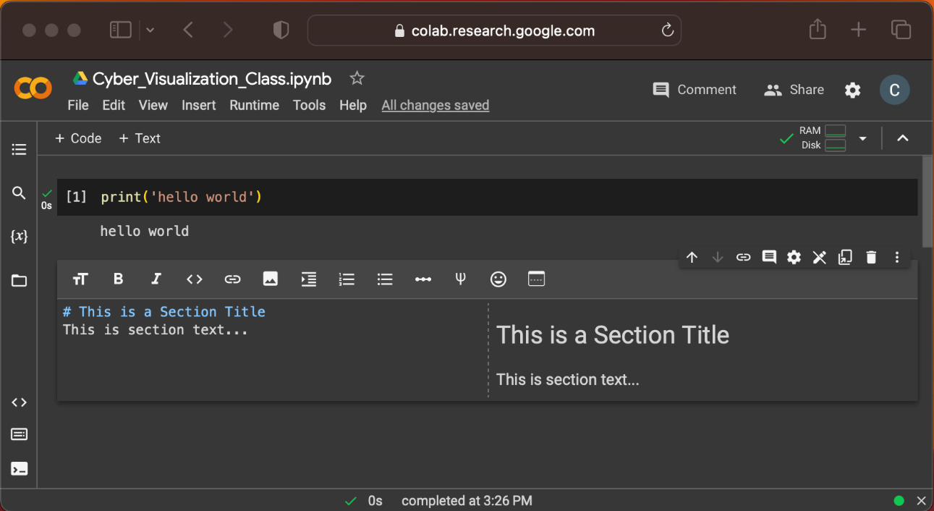
Colab: Getting Started – 3
Click + Text to create a text cell
Add formatted text throughout your notebook to explain the analysis
Use # (hashtag symbol) for section titles

Slide 24
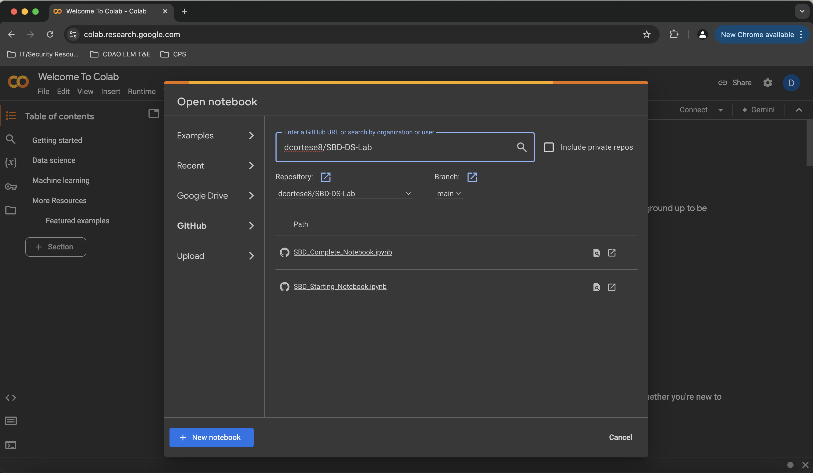
Import Lab Notebook
Click File > Open Notebook > GitHub
Type dcortese8/InfoSec-World-DS-Lab into the search box.
Two *.ipynb files will appear for selection. Select InfoSecWorld_Starting_Notebook.ipynb (you can open the other notebook later for solutions.)

Slide 25
Problem Analysis

Slide 26
Data Science Lifecycle
Notes:
Close loop summary to purpose
Iterate data cleaning and modeling

Slide 27
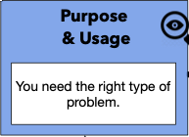

What makes a good candidate for a data science or machine learning project?
Start with a valuable process that could be better, faster, or cheaper if data/predictions were available to it
Then, consider:
Suitability: Is this the correct tool for the task?
Feasibility: Can you perform the task at a level that meets business goals?
Advisability: Is the use ethical? Do the benefits outweigh the costs?
Notes:
Emil

Slide 28
Advisability and Explainability
Flint, Michigan developed an ML system to predict which homes had lead pipes that needed to be replaced.
Performance was reasonably good, ~70% accuracy
The city scrapped the system. They could not convey to the public how the algorithm worked, and why some houses were prioritized over others
“When we started this, people would say, ‘You did my neighbor’s house and you didn’t do mine,’” [Mayor] Weaver said
Recommendation: Factor in explainability requirements during planning of a DS Project
https://www.theatlantic.com/technology/archive/2019/01/how-machine-learning-found-flints-lead-pipes/578692/
Notes:
Emil

Slide 29
Define Lab Problem
Suppose Company A’s SOC monitors 23 Linux honeypots deployed in a public cloud environment
Over a 5-hour collection window, telemetry captured an adversary campaign
Each host generates kernel-level process events and DNS logs
The challenge: These attacks are not easily identifiable, so we must find the hidden patterns that indicate an attack
GOAL: Given activity from multiple hosts and as Data Scientists, we aim to build an anomaly detector that flags potential attacks on new host activity.
Suitability: Is this the correct tool for the task?
Feasibility: Can you perform the task at a level that meets business goals?
Advisability: Is the use ethical? Do the benefits outweigh the costs?
Notes:
Emil

Slide 30
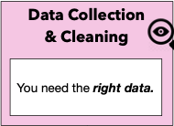
BETH Cybersecurity Dataset
BETH* is real cybersecurity dataset published in 2021 as a benchmark for anomaly detection researchers
8 million records, generated by 23 hosts, during 5 discontiguous hours
*Highnam, K., Arulkumaran, K., Hanif, Z., & Jennings, N. R. (2021). "BETH dataset: Real Cybersecurity Data for Anomaly Detection Research." ICML 2021 Workshop on Uncertainty and Robustness in Deep Learning. http://www.gatsby.ucl.ac.uk/~balaji/udl2021/accepted-papers/UDL2021-paper-033.pdf
Suppose this dataset is a representative sample of Company A’s telemetry.
Notes:
Emil
Humans labelled it

Slide 31
BETH Cybersecurity Dataset System Log
timestamp: seconds since system boot
processId: integer label for the process spawning this log
threadId: integer label for the thread spawning this log
parentProcessId: parent's integer label for the process spawning this log
userId: login integer ID of user spawning this log
mountNamespace: set mounting restrictions this process log works within
processName: string command executed
hostName: name of host server
eventId: ID for the event generating this log
eventName: name of the event generating this log
stackAddresses: memory values relevant to the process
args: list of arguments passed to this process
argsNum: length of 'args'
returnValue: value returned from this event log (usually 0)
sus: binary label as a suspicious event (1 is suspicious, 0 is not)
evil: binary label as a known malicious event (1 is malicious, 0 is not)
Temporal Features
Relational Features
Semantic Features
Aggregate Features
Notes:
Emil

Slide 32
BETH Cybersecurity Dataset DNS Log
timestamp: Date and time in the format “YYYY-MMDDTHH:MM:SSZ” for when the packet was sent or received
SourceIP: Source IP address of the packet
DestinationIP: Destination IP address of the packet
DNSQuery: Sent DNS query (e.g. the URL submitted - "google.com")
DNSAnswer: DNS response; can be null
DNSAnswerTTL: List of integers sent as strings, can be null; The time to live of the DNS answer
DNSQueryNames: Name of the requested resource
DNSQueryClass: Class code for the resource query
DNSQueryType: Type of resource record (A, AAAA, MX, TXT, etc.)
NumberOfAnswers: Number of answer headers in the packet
DNSOpCode: Header information regarding which operation this packet was sent (e.g. standard query is 0)
SensorID: Same as the hostName in the process records; Name of host server
sus: binary label as a suspicious event (1 is suspicious, 0 is not)
evil: binary label as a known malicious event (1 is malicious, 0 is not)
Notes:
Emil

Slide 33
BETH Cybersecurity Dataset Sample
System Logfiles
DNS Query Logfiles
Notes:
Emil

Slide 34
Coding Exercise 1

Slide 35
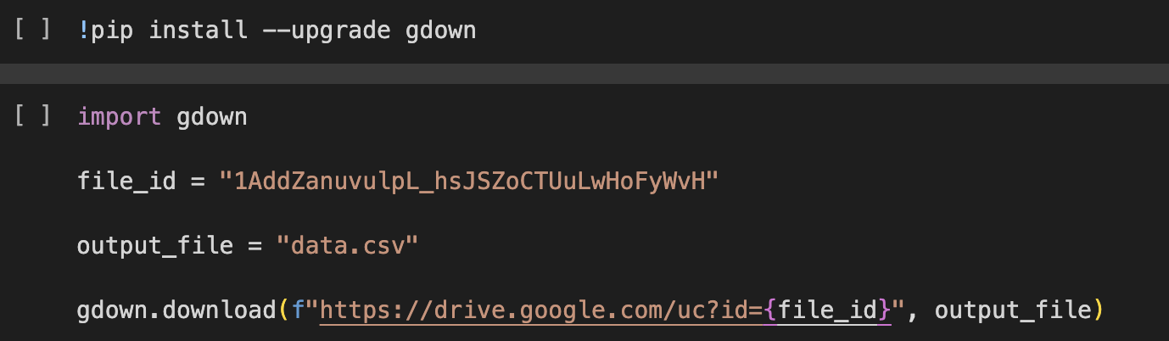
Download Lab Dataset
Before we get started, let’s add the BETH dataset to our Colab environment
Run the Download Dataset code cells in the starter notebook that you opened from Github.

Slide 36
Install and import libraries
We now import all libraries required for the notebook:
matplotlib is for plotting.
numpy is a low-overhead data management library using arrays.
pandas is a high-overhead data management library that uses dataframes.
sklearn contains many convenient methods for predictive modeling.
umap implements dimensionality reduction techniques.
Notes:
Simplify this slide

Slide 37
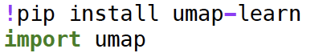
Install and import libraries

Slide 38
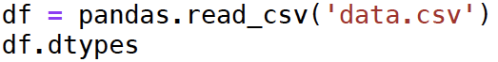
Read .csv into dataframe

Slide 39
Pandas Data Types
When importing a .csv into your notebook, Pandas will automatically determine the datatype of each column:
int64: Integer values (e.g., 42, -3)
float64: Floating-point numbers (e.g., 3.14, -0.001)
object: General type for mixed or string data (e.g., "Hello, World!", [1, 'a', 3.14])
bool: Represents True or False
datetime64[ns]: Date and time values with nanosecond precision (e.g., 2023-07-30 12:00:00)
timedelta[ns]: Differences between two datetime values with nanosecond precision
category: Finite list of text values (e.g., ['small', 'medium', 'large']), which can be ordered or unordered

Slide 40
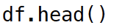
View first 5 records

Slide 41
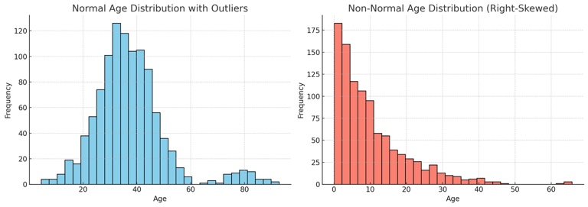
Exploratory Data Analysis (EDA)
Important to understand your data before building models
Data Exploration: Essential for understanding the underlying characteristics of data.
Preprocessing Insight: Helps in deciding how to clean and transform data for better analysis.
Model Assumptions: Checks for normality or other distribution-specific requirements in data.
Use matplotlib to build plots and charts to gain insight into dataset (e.g., histograms)
Notes:
What is a distribution?
Keep anomaly detection in mind, not regression

Slide 42
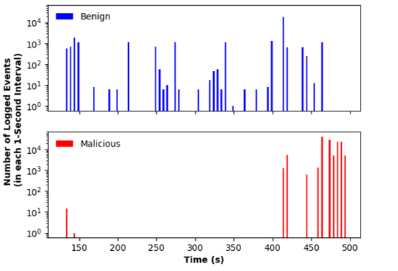
Logged Events in Time on the Attacked Host
Notes:
Emil

Slide 43
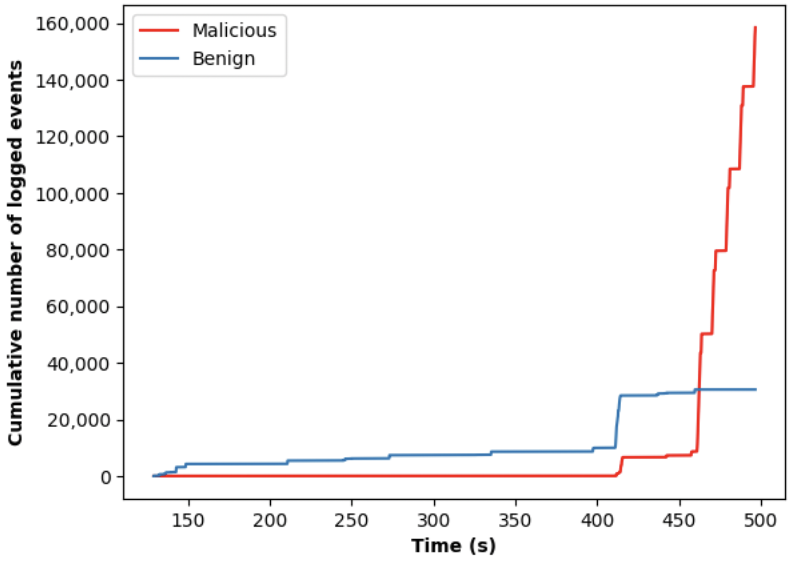
Logged Events in Time on the Attacked Host
Notes:
Emil

Slide 44
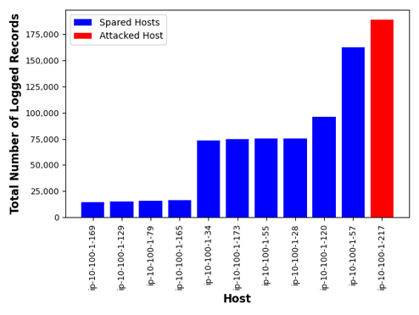
Logged Events by Host
Notes:
Emil

Slide 45
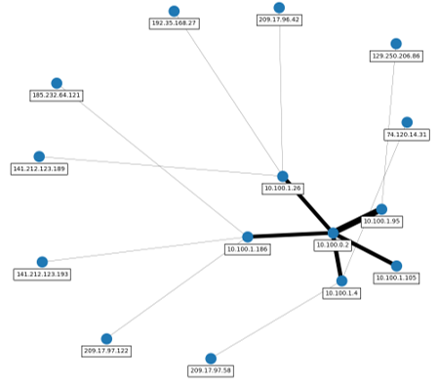
DNS Query Traffic between IP Addresses
Notes:
Emil

Slide 46
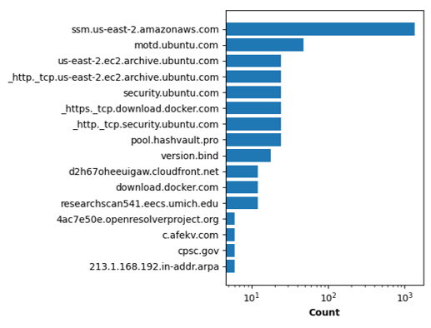
DNS Query Volume by Domain Name
Notes:
Emil

Slide 47
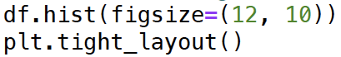
Histograms of the raw data

Slide 48
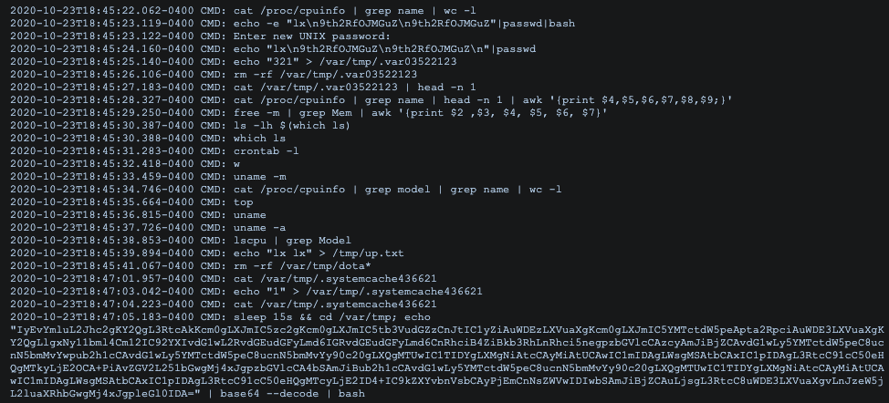
Feature Engineering (Pre-processing)
Feature engineering transforms raw data into meaningful features to improve the performance, interpretability, and robustness of machine learning models.
We perform some transformations to better prepare for the model training process:
Remove from dataset: timestamp, threadId, processName, hostname, eventName, stackAddresses, args, sus
Map to binary variable: processID, parentProcessID, userId, mountNamespace
Map to categories: returnValue
No change: eventId, argsNum
See Lab notebook for explanations of each transformation
Source: https://blog.edie.io/2020/10/31/honeypot-diaries-dota-malware/
Notes:
Hostname as example
ProcessID binary bc we can separate user process vs. system process (look at BETH)
Emphasize diff bw sus and evil (why are we removing sus)

Slide 49
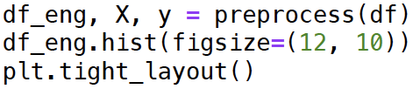
Histograms of the engineered features

Slide 50
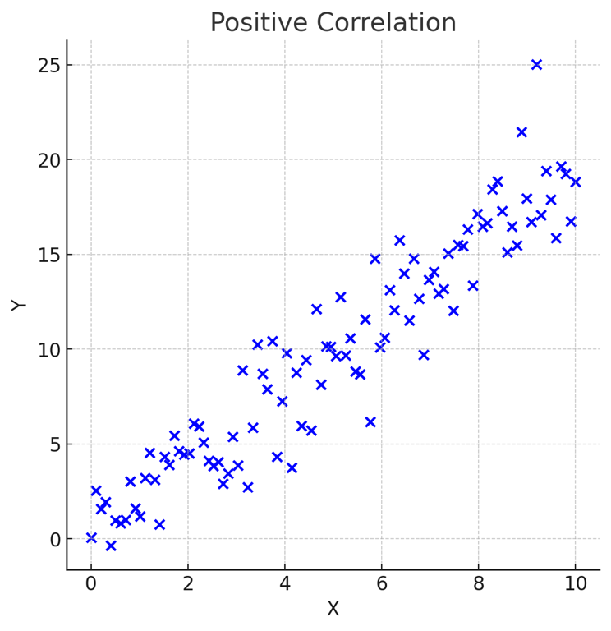
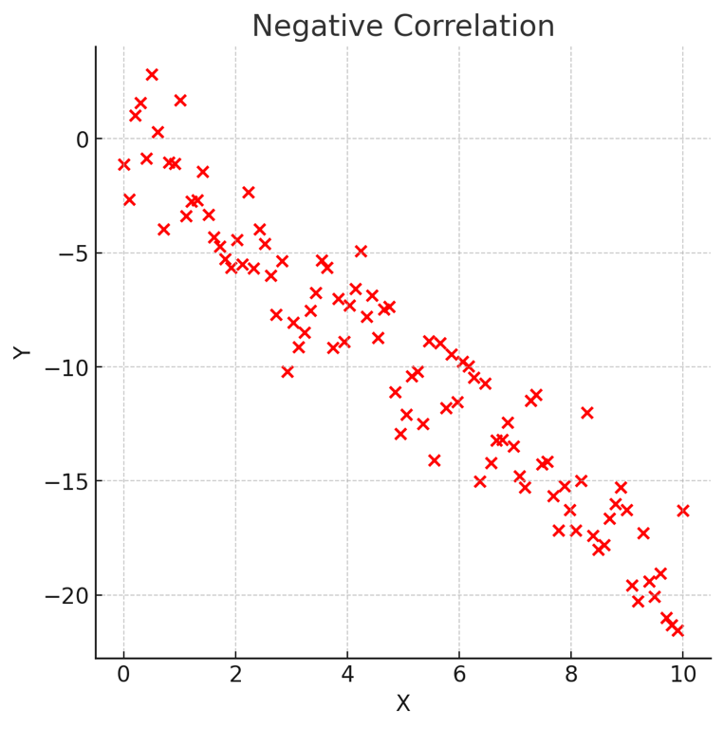
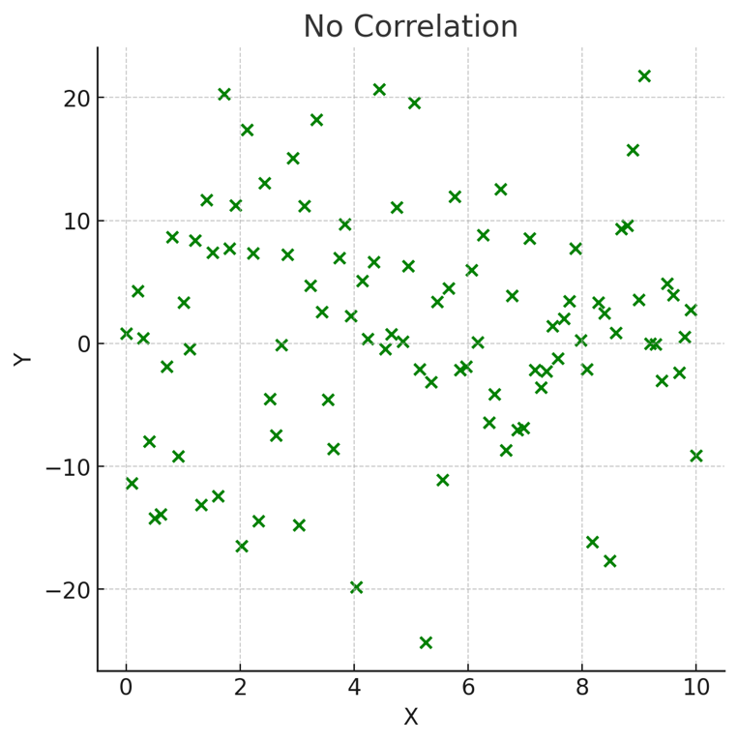
Understanding Correlation
Correlation measures the strength and direction of the relationship between two variables.
Positive Correlation:
Both variables move in the same direction.
Example: Height and Weight.
Negative Correlation:
One variable increases while the other decreases.
Example: Exercise and Body Fat Percentage.
No Correlation:
No predictable relationship between the variables.
Example: Shoe Size and Intelligence.

Slide 51
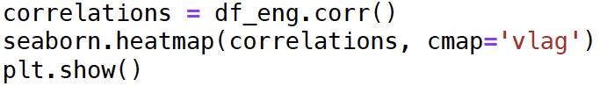
Correlations plot

Slide 52
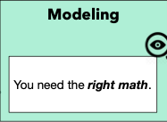
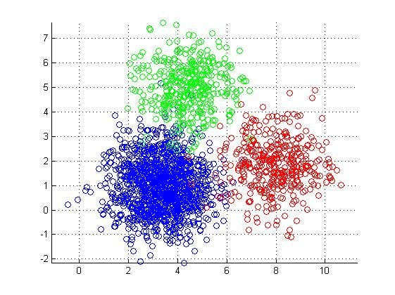
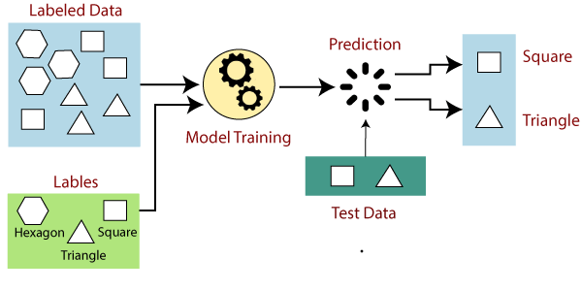
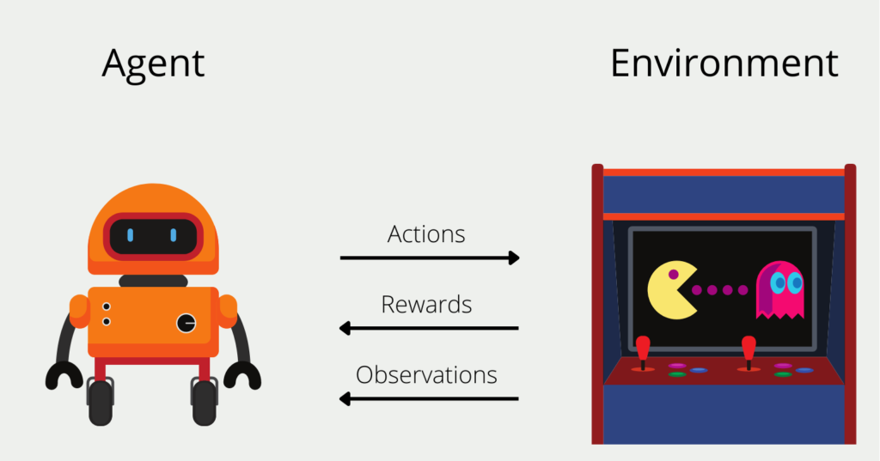
Common classes of ML methods
Supervised Machine Learning​
Unsupervised Machine Learning​
Reinforcement Learning​
Used for making predictions given labeled data
Threat detection: Given known examples of malicious and benign activity, classify new behavior as malicious or benign
Used for discovering previously unknown patterns in data
Network Intrusion Detection: Anomaly detection algorithms analyze network traffic for abnormalities (e.g., spikes in data transfer)
Used for optimization in complex, but constrained tasks
Automated Incident Response: Agent selects the optimal response given a potential web request
Block request
Request analyst feedback
Notes:
· There are a lot of different types of machine learning methods but most of them fall into 3 common classes
· Supervised learning is used when there’s a characteristic you want to predict and you use all the other features to learn relationships predictive of the characteristic
o Such as when you have prior records for malicious or benign behavior, and you’re interested in predicting whether new behavior will be malicious or benign
· Unsupervised learning is the set of problems when you don’t have these concrete characteristics to predict but you’re still interested in finding the hidden structures within your data
o There are a lot of different forms of unsupervised learning algorithm, and some of them will be featured in the practical
o One common class are anomaly detection algorithms, where you’re interested in noticing significant differences from normal behavior in the data, but you don’t actually have a label for the “different” behavior you’re looking for

Slide 53
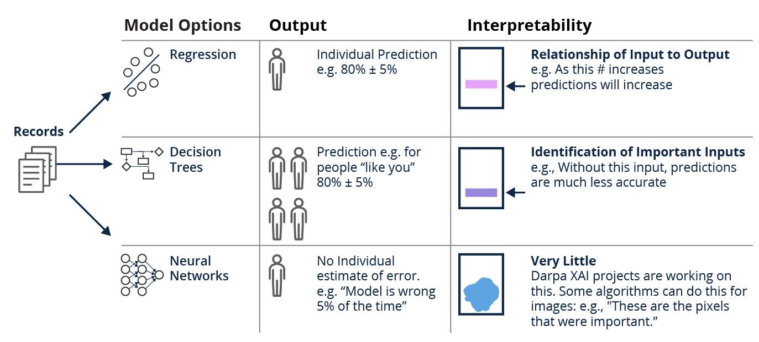
Options for models reflect trade-offs between complexity and interpretability
Notes:
Once you have an idea of the general set of algorithms you would like to consider, you have to also think about their complexity and interpretability.
In other words you have the option of choosing models that are simple and easy to interpret like linear regression or really complex deep neural networks that are far less explainable
For example, refer back to the correlation slide
Whereas if we consider deep neural networks, therse models end up having millions and sometimes billions of these “slopes” or parameters
Our recommendation is generally to start with simple models that are interpretable and only add complexity if those models don’t work as well

Slide 54


Dimensionality Reduction
Technique to simplify large datasets by reducing the number of variables (columns) while keeping important information.
Merges columns together to project high-dimensional data into a lower dimensional space.
Easier to Understand: Simplifies complex data.
Better Insights: Highlights key patterns and trends.
Faster Processing: Makes data analysis quicker and more efficient.
Original Data
Reduced Data
100% Information
90% Information
Notes:
In many cases we’re forced to use more complex models because our dataset is already too complex in itself
What do I mean by that? Well our dataset may have a ton of different columns, oftentimes columns that are very similar and share the same underlying meaning or information (like height and weight represent the size of a person)
And this can be a problem because an increase in complexity harms the performance of the model - it causes the model to overfit or learn the training data too well, and not generalize to unseen data
And I’ll talk more about that shortly…..
So a way to mitigate this complexity is through dimensionality reduction…..

Slide 55
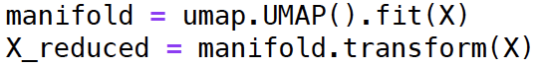
UMAP dimensionality reduction

Slide 56
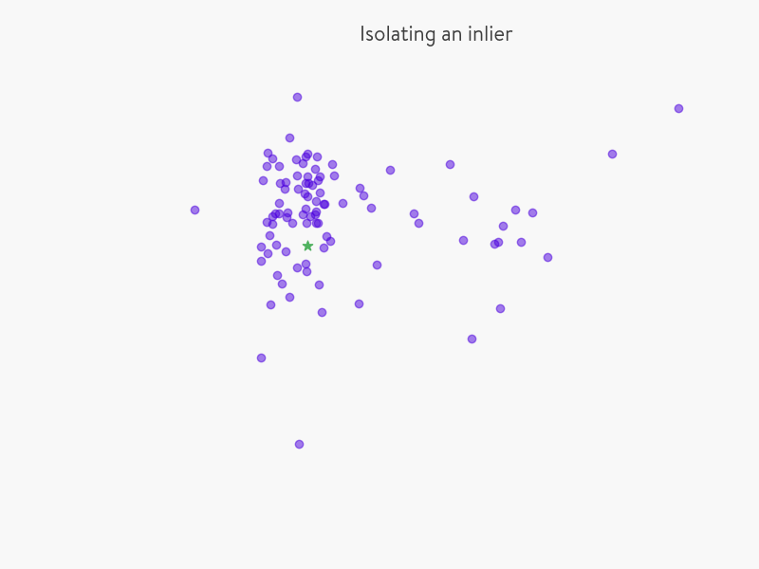

Iso-Forest Model
Train anomaly detector model to separate malicious/evil records from random subsets of our transformed data
Iso-forest is an unsupervised algorithm that leverages an ensemble of decision trees to isolate outliers from a given data sample
For each individual record in our input data set, how many iterations are needed to separate the record from the others?
Decision scoring:
Records with a low number number of iterations receive negative scores, indicating outliers
Each record receives a score from each decision tree, and then averaged together for a final score
Source: https://quantdare.com/isolation-forest-algorithm/

Slide 57
Fit anomaly detecting isolation forest model

Slide 58
Model Assessment
Assess the performance of the trained model using a confusion matrix
Final scores become binary
Negative scores → 1 (Outliers, Malicious)
Positive scores → 0 (Not outliers, benign)
We compare the binary scores with the ground truth evil labels
Confusion matrix helps us visualize this comparison
We hope to see high numbers along the highlighted diagonal, indicating correct scores
# of True Negatives | # of False Positives
# of False Negatives | # of True Positives
Benign (0)
Actual
Evil (1)
Benign (0)
Evil (1)
Predicted

Slide 59
Measuring performance for ML systems requires you to define and prioritize errors
Metric | What it measures
Accuracy | How often is the algorithm correct?
Precision | Of the “yes” values that were predicted, how many are actually ”yes”?
Recall / Sensitivity | Of the "yes" values in the data, how many were predicted as "yes"?
Specificity | Of the “no” values that were predicted, how many are actually ”no”?
The metrics you choose for an ML project are a policy statement about what kind of systematic errors are acceptable, and which should be minimized.

Slide 60

How do you make sure a ML model is generalizable?

Slide 61
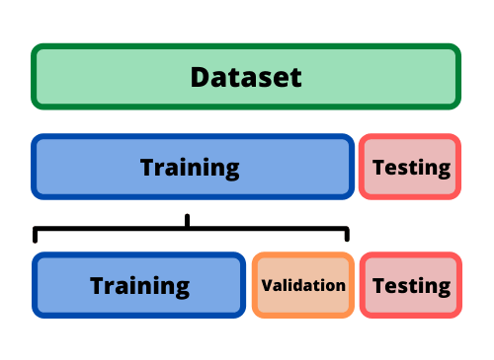
How do you make sure a ML model is generalizable?
Systematically withhold data from the model and use the data to measure effectiveness on new information
Make sure the withheld data are representative of new data!

Slide 62
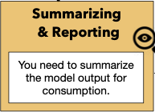
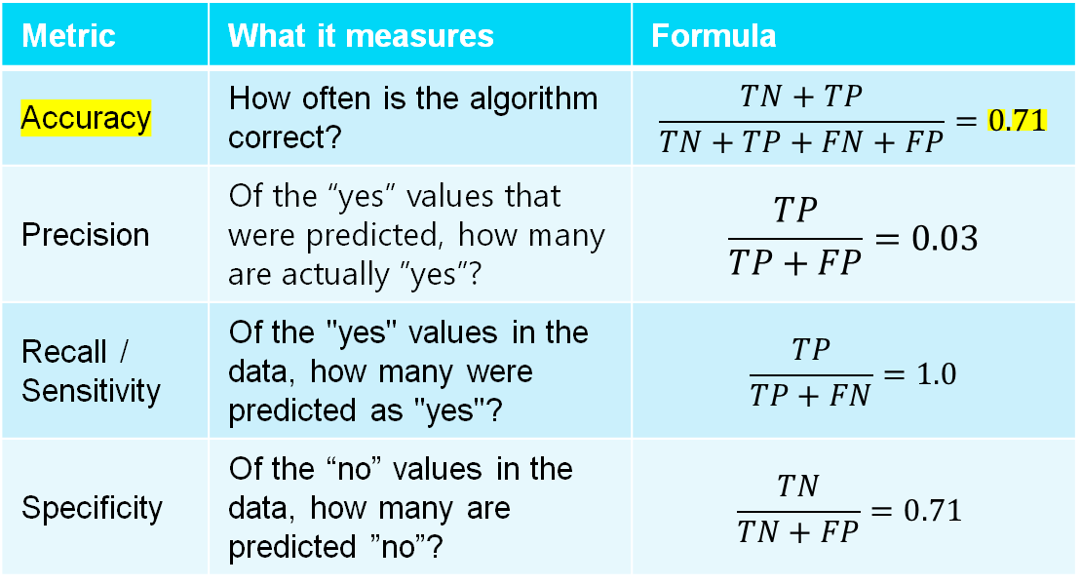
How do we communicate these results?
Metric | What it measures | Formula
Accuracy | How often is the algorithm correct? | $$\frac{TN+TP}{TN+TP+FN+FP}=0.71$$
Precision | Of the “yes” values that were predicted, how many are actually ”yes”? | $$\frac{TP}{TP+FP}=0.03$$
Recall / Sensitivity | Of the "yes" values in the data, how many were predicted as "yes"? | $$\frac{TP}{TP+FN}=1.0$$
Specificity | Of the “no” values in the data, how many are predicted ”no”? | $$\frac{TN}{TN+FP}=0.71$$
TN = 3534 | FP = 1416
FN = 0 | TP = 50
Benign (0)
Actual
Evil (1)
Benign (0)
Evil (1)
Predicted
Notes:
The most important thing to report as a data scientist is that our model does not consider any actual malicious samples as benign (recall or TPR is 100%). This is the last thing we would want.
Many actual benign samples were classified as malicious by our model, meaning it is an extremely cautious model
However, it may be too cautious!
Frame this as a tradeoff
So we know if we were to deploy this model, then we could be confident that it won’t miss legit evil samples

Slide 63
Data Science Lifecycle Revisited
Build anomaly detector for malicious traffic
BETH dataset
Explore features
Transform features
Reduce dimensions
Fit iso-forest model
Evaluate model performance
Determine if model is sufficient
Did we accomplish our goal?
Notes:
Close loop summary to purpose
Iterate data cleaning and modeling

Slide 64
Timeless principles for practicing data science
Begin with a clear objective for a system tied to a business problem, with a definition of success
Think about how the information you have translates into a prediction, with the help of content area experts
Verify relationships/patterns in data before attempting to use models
Use the simplest, most explainable, models first
Be prepared for errors
Notes:
Examples:
Use AI to revolutionize business process X
IP addresses as a feature. Consider: could a human reliably make that prediction if they had time to look through all the data.
Don’t immediately think “we want to use AI”
· So that about wraps up lab 1
· but I wanted to go over a few data science principles before we move to exercise 2
o Start your project with a clear problem and objective for using machine learning
o On the data side: Constantly consider how the data you collect and the transformations you make on it can affect you models and prediction
o On the modeling side: Start with simple models and add more complexity if you notice your model is underfitting
§ All else being equal you want to use the simplest and most explainable model
o Expect and be tolerant for errors in your model’s prediction, be sure to communicate this uncertainty to the end users

Slide 65
Coding Exercise 2

Slide 66
Task Overview
PROBLEM: Existing static code analysis tools provide descriptive, aggregated measures of code that provide insight into software architecture, complexity, design etc. without mapping code attributes to risk of vulnerability.
GOAL: Given output from static code analysis tools (OpenStaticAnalyzer and escomplex), can a model be trained to predict vulnerable functions within code using historic data?
DATASET: JavaScript vulnerability dataset collected, cleaned and processed by Dept of Software Engineering from University of Szeged, Hungary (2019) ¹.
1. R. Ferenc, P. Hegedűs, P. Gyimesi, G. Antal, D. Bán and T. Gyimóthy, "Challenging Machine Learning Algorithms in Predicting Vulnerable JavaScript Functions," 2019 IEEE/ACM 7th International Workshop on Realizing Artificial Intelligence Synergies in Software Engineering (RAISE), Montreal, QC, Canada, 2019, pp. 8-14, doi: 10.1109/RAISE.2019.00010.

Slide 67
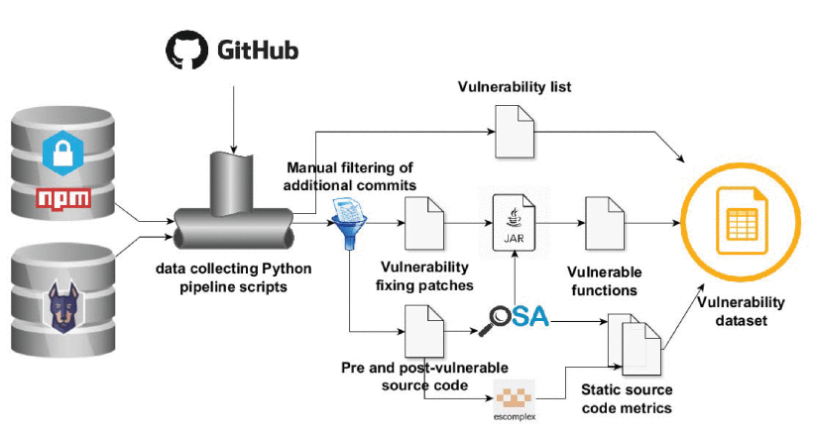
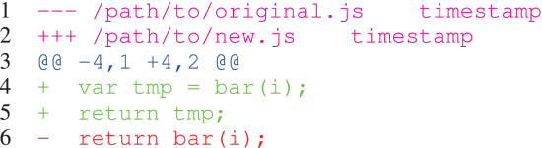
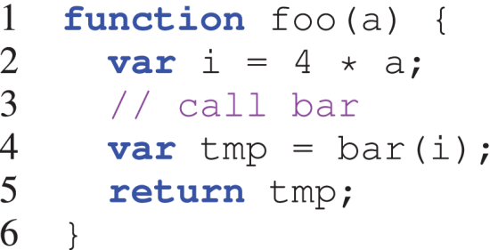
JavaScript Vulnerability Dataset Pipeline
Extract packages identified as vulnerable from Node Security Project (NSP) and SNYK vulnerability databases.
Collect URLs pointing to fixing commits, pull requests or issues in GitHub repos.
If URL points to a fixing commit or merged/pull request, add the commit(s) hash(es) to the fixing list.
If URL points to an issue, comments are traversed manually to identify URLs pointing to vulnerability issue.
After fixing commit list is finalized for each vulnerability, all code modifications are collected in the form of a combined patch file (per vuln) containing all the modification from the fixing commits.
The parent commit of each vuln is identified and the function version associated with that commit is marked as vulnerable. If the code modifications (patch file) affects the code, they are marked vulnerable.
Functions are matched by examining the diff file in the patches and checking if function n overlaps in line position identified by OSA and in diff file.

Slide 68
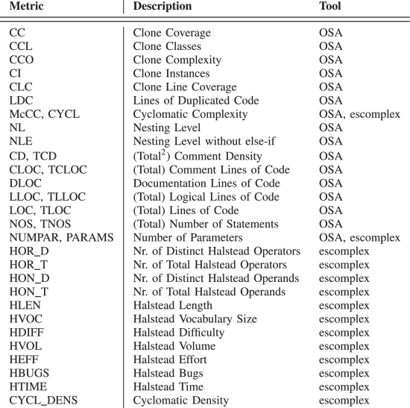
Data Processing
OpenStaticAnalyzer and escomplex are run on identified code to derive:
Size Metrics: Total Lines of Code, Logical Lines of Code, etc.
Documentation Metrics: Comments, Docs, etc.
Clone metrics: Relating to clone coverage, classes, complexity, instances, etc.
Complexity metrics: Cyclomatic and nested.
Halstead metrics: Uses total and unique number of operators and operands to capture vocabulary, volume, time, etc.
Resulting dataset contains a 35 dimensional record for each observed file along with a labelled vulnerability status (1 = vulnerability detected, 0 = vulnerability not detected).

Slide 69
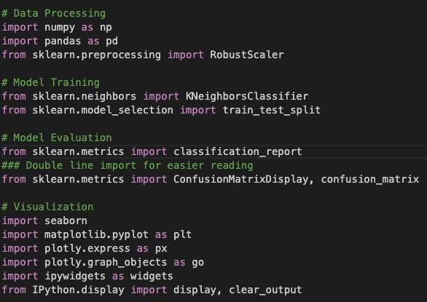
Install and Import Libraries

Slide 70
Tasks
Read the csv into a dataframe using pandas.
View the first 5 rows of the dataframe.
Identify and remove non-numerical features from the dataframe.
Plot histograms of the raw data

Slide 71
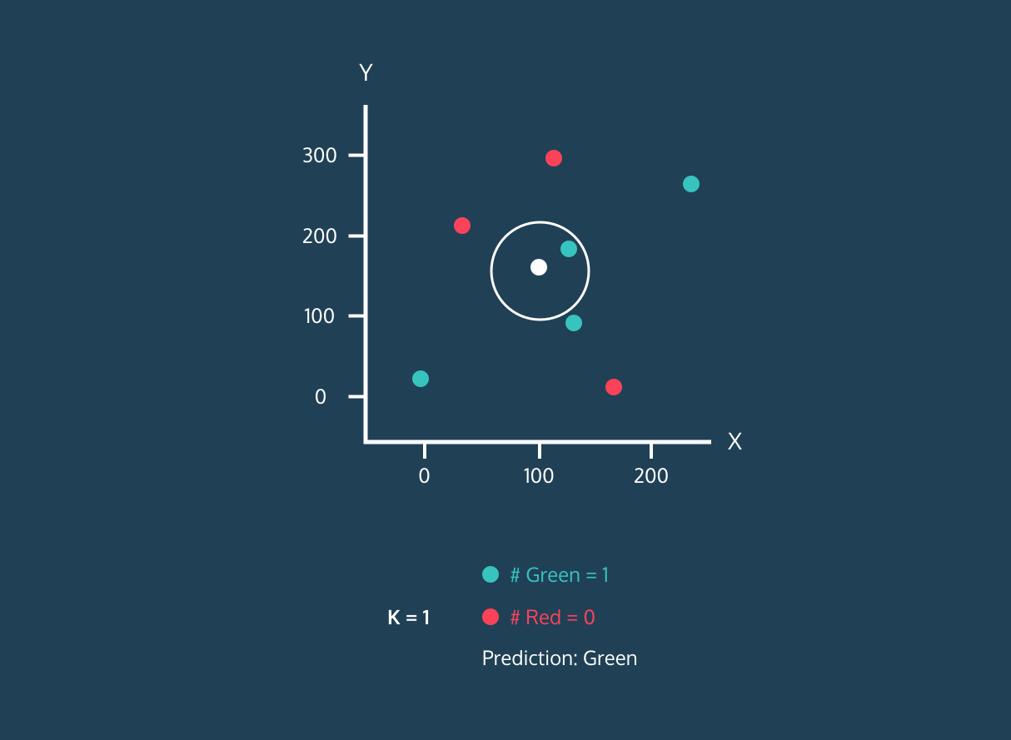
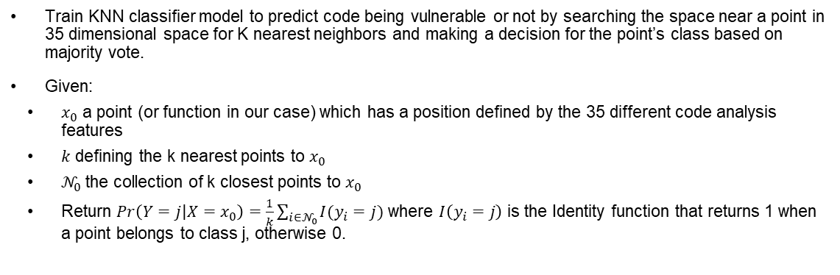
K-Nearest Neighbors Classification
Train KNN classifier model to predict code being vulnerable or not by searching the space near a point in 35 dimensional space for K nearest neighbors and making a decision for the point’s class based on majority vote.
Given:
$x_{0}$ a point (or function in our case) which has a position defined by the 35 different code analysis features
$k$ defining the k nearest points to $x_{0}$
$𝒩_{0}$the collection of k closest points to $x_{0}$
Return $Pr\left(Y=j | X=x_{0}\right)=\frac{1}{k}\sum_{i∈𝒩_{0}}{I(y_{i}=j)}$ where $I\left(y_{i}=j\right)$ is the Identity function that returns 1 when a point belongs to class j, otherwise 0.
# of True Negatives | # of False Positives
# of False Negatives | # of True Positives
Kim, E. (2019, October 20). KNN(K-nearest neighbors) 알고리즘 개념정리. KNN(K-Nearest Neighbors) 알고리즘 개념정리. https://blog.eunsukim.me/posts/understanding-KNN
Vuln Not Detected (0)
Actual
Vuln Detected (1)
Vuln Not Detected (0)
Vuln Detected (1)
Predicted

